Slide 1
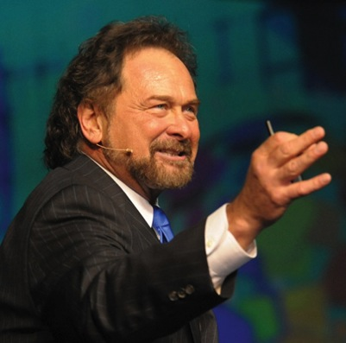
有效建立團隊 Effectively Building An Organization
Dennis Franks
執行副總裁 Executive Vice President
本簡報中提到的收入等級純屬舉例說明，無意代表美安香港經銷商的一般收入，也無意表示任何經銷商皆可賺取同等收入。美安香港經銷商的成功與否，取決於其在發展事業時的努力、才能與投入程度。The income levels mentioned in the following presentation are for illustration purposes only. They are not intended to represent the income of a typical Market Hong Kong Distributor, nor are they intended to represent that any given Independent Distributor will earn income in that amount. The success of any Market Hong Kong Independent Distributor will depend upon the amount of hard work, talent, and dedication which he or she devotes to building his or her Market Hong Kong Business.

Slide 2
美安香港 MARKET HONG KONG

Slide 3
有效建立團隊 Effectively Building An Organization
擴展組織
帶領團隊
培訓新領袖
Expanding Distribution
Leading Your Organization
Develop New Leaders

Slide 4
美安香港四大基石 Four Cornerstones of Market Hong Kong
產品分銷 Product Brokering
管理業績紅利計劃Management Performance Compensation Plan (MPCP)
超連鎖™事業發展系統UnFranchise™ Business Development Systems
一對一行銷及社交購物 One-to-One Marketing and Social Shopping

Slide 5
“積極進取型” 超連鎖™店主
表現專業
需要學習技能
有目標
有上進心
精通成功五要訣
“Go Now” UnFranchise™ Owner
These are the professionals
Need to learn skills
Have a goal
Driven
Master the Basic 5

Slide 6
“Go Now” UnFranchise™ Owner
“積極進取型” 超連鎖™店主
不是靠運氣，需行動成為“積極進取型” 超連鎖™店主
了解2-3年計劃
不是一個令你快速致富的計劃
不是依賴他人便能成功
不是靠著你的位置或所屬的團隊便能成功的計劃
不是走捷徑，而是如何更聰明地工作
這是一個已證實可行的計劃
Makes it happen. It is not about luck.
Understands a 2 – 3 year plan
NOT a get-rich quick scheme
NOT dependent on others, riding their coat tails
NOT about your position or right organization
NOT about shortcuts but about working smarter
This is a Work Program

Slide 7
The UFO Skills For Recruiting
超連鎖™店主招募技巧
尋找潛在人選或把豆罐裝滿
列出一個詳細的名單
把你認識的人名寫下來
每個人都認識某些人
做應做的事情，而且專業地做
Finding Prospects or Filling The Bean Jar
Make a comprehensive list
Do you know somebody, then list everybody.
Everybody knows somebody.
Do the work...be the professional.

Slide 8
超連鎖™店主招募技巧
學習每天尋找新名單
永不停止尋找新名單
定期為名單加入新朋友的資料
每天加入兩個新名單
The UFO Skills For Recruiting
Learn to find new people daily
Never stop finding new people.
Constantly add new people to your list.
Expand your list by adding two (2) names daily.

Slide 9
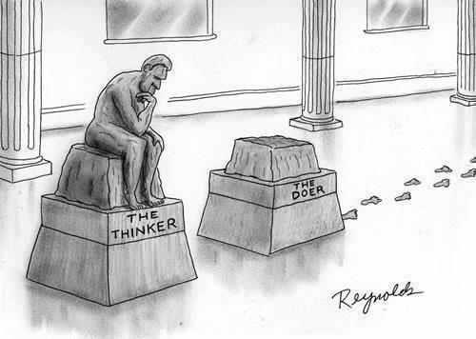

Slide 10
學習…
...
邀約你的潛在夥伴出席活動
轉移你的信念到產品或商業模式上
教育同時建立關係，並提供具常識性的解決方案
To invite your prospects to an event.
Transfer your belief in the product or business model.
To educate, build relationships and offer common-sense solutions.

Slide 11
一個活動可以是…
二對一
三方會議
電話會議
（現場或預錄）
在家中或辦公室的小組演講
網上研討會 – (MeetON)
本地酒店會議
公司活動
An Event can be a ...
Two-on-One
Three-way Call
Conference Call
(live or recorded)
Small Group Presentation in the Home or Office
Online Webinar – (MeetON)
Local Hotel Meeting
Company Event

Slide 12
如果這不是一個活動，把它視為一個工具
利用工具教導你的潛在夥伴
錄音、書籍、視頻、網上連結
If Not An Event, Make It A Tool
Use tools to educate your prospect
audio, literature, video, links

Slide 13
Identify Your Favorite Tools
選用你喜歡的工具
年報
meetON.com
有關美安集團電子檔案和下載UFMS內的檔案
Motives.com.hk
HK.SHOP.COM入門網站
起步指南
Instagram – (Motives®, TLS®)
產品單張
GLOBAL.SHOP.COM
Annual Global Report
meetON.com
About ma PDF and UFMS Download
Motives.com.hk
HK.SHOP.COM
Getting Started Guide
Instagram – (Motives®, TLS®)
Product Fliers
GLOBAL.SHOP.COM

Slide 14
TIPS: To invite a Prospect to an event or review a tool
提示：邀約潛在夥伴出席活動或了解工具
做回自己
過程中把自己的情感抽離
表現你的熱情“熱情會互相感染”
保持“必定要成功”的氣勢
Be yourself
Emotionally detach yourself from the process
Bring some passion “Enthusiasm is contagious”
Keep your posture “Decide to be a success”

Slide 15
怎樣進行邀約
THE
TO INVITE

Slide 16
盡快與對方聯絡
禮貌地問候潛在夥伴
發出邀請
如果我… 請問你會不會
確認 1… 取得對方對時間的承諾
確認 2… 確認對方對時間的承諾
確認 3… 約定下次聯絡對方的最佳時間
掛線
跟進
Be in a hurry
Compliment the Prospect
Make the invitation
If I...would you
Confirmation 1...get the time commitment
Confirmation 2...confirm the time commitment
Confirmation 3...schedule the next call, best time
Get off the phone
Follow up

Slide 17
邀約朋友、家庭成員或相熟朋友之示範
A SAMPLE INVITE
FOR A FRIEND,
FAMILY OR ACQUAINTANCE

Slide 18
你好Andy。我就快出門口，但諗起有啲重要事想同你傾兩句先。
識你咁耐，知道你一直以嚟都將每件事做到最好。
所以我想邀請你參加個特別研討會，喺有關一個利用科技同網上購物既商業模式。
Hello Andy. I was on my way out the door, but needed to talk with you real quick.
For as long as I have known you, you have been the best of what you do.
I want to invite you to attend a special seminar that is representing a business model, leveraging both technology and online shopping.

Slide 19
如果我安排埋門票俾你，你會唔會參加？個研討會喺12號，星期三晚上７點半。
咁12號，星期三晚，約定邊個時間一齊去好？
太好喇，咁我哋12號星期三晚6點半喺邊度等？
If I provide you a ticket to this seminar, would you attend? It is Wednesday, the 12th, 7:30 p.m.
What is the best time to pick you up on Wednesday, the 12th?
Great, so I will pick you up at 6:30 on Wednesday, the 12th. At what location?

Slide 20
好！我哋約定12號星期三晚6點半，你office附近九龍灣地鐵站A出口等。
到時見。我而家要出街先！
Great, so I will pick you up at 6:30 on Wednesday, the 12th at your office. 14 West Friendly Avenue at 6:30 p.m.
Excellent! See you then. Have to run!

Slide 21
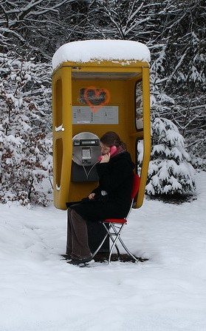
邀約經轉介或
從冷市場而認識
的朋友了解資訊之示範
A SAMPLE INVITE
A Third-Party Referral or
Cold Call
TO REVIEW INFORMATION

Slide 22
你好Andy。
我喺Dennis 。我知今次打比你有啲唐突，同埋我地都好忙，所以我長話短說吧。我喺報紙上見到你被嘉許為成功人士，恭喜你。我知道你有好好既人際網絡，又有良好既溝通技巧，而且正尋找緊一些可改善你的現在財務狀況既計劃，係咪？
Hello Andy.
This is Dennis. I know this is not a scheduled time to speak, and we both are on the go. I saw your name in the paper. Congratulations on your success. I understand you are well connected, with wonderful communication skills and looking to improve your financial position. Is that correct?

Slide 23
Other Intro Options
其他打開話題的選擇
是xxx介紹你給我認識
我在報紙上見到你被嘉許為成功人士，恭喜你！
我跟朋友聊天時他提起你的名字…
我曾經在你店內買東西…
我們有共同認識的朋友…
I was referred to you by...
I saw your name in the paper. Congratulations on your success!
Your name came up in a conversation with friends...
I was in your store...
We have a mutual friend...

Slide 24
如果我發個短片連結俾你，你會睇嗎？
好！你可以俾個電郵地址我嗎？你會幾時睇？短片只喺15分鐘。
太好喇！如果你星期二晚睇，咁我星期三早上打俾你，同你傾下有關內容，可以嗎？
If I sent you a link to a short video, would you watch it?
Great! Can I have your email address. When would you be able to watch it by, for sure. It’s just 15 minutes.
Excellent! So, if you watch it by Tuesday night, and I called on Wednesday morning, would you have seen it for sure?

Slide 25
好！星期三早上邊個時間打俾你比較方便？9點前定11點後？
太好… 我哋之後再傾。
Great! What is the best time to call you on Wednesday morning? Before 9 or after a 11?
Excellent...talk to you then. Have to run and I’ll let you get back to your busy schedule.

Slide 26
主管超連鎖™店主計劃
現在就是時候完成此計劃！
The Master UFO Program
The time is NOW to make it happen!

Slide 27
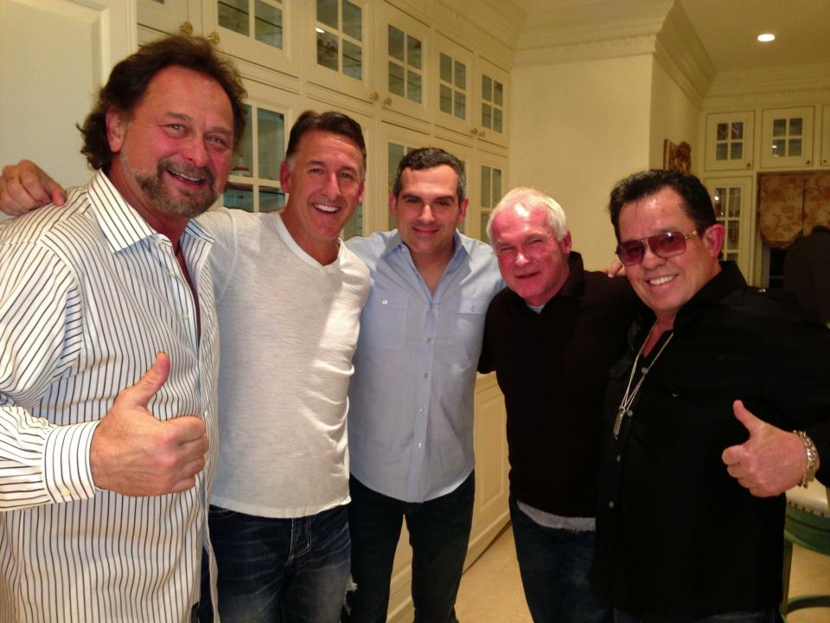
專業的超連鎖™店主 Professional UnFranchise™ Owners
利用工具 利用現場活動
及跟其他專業的超連鎖店主學習
Use Tools
Use Live Events and Other Professional UFOs

Slide 28
選擇訂立一個必勝的願景
Choose to have a vision of victory.
我充滿“做得到”的力量。
時刻保持一個勝利者的心態，所想的必會實現。
團隊… 團隊… 團隊
I am full of “can do” power.
Keep a victor’s mentality because a victor’s mentality becomes a victor’s reality.
THE TEAM...THE TEAM...THE TEAM

Slide 29
有效建立團隊 Effectively Building An Organization
擴展組織
帶領團隊
培訓新領袖
Expanding Distribution
Leading Your Organization
Develop New Leaders

Slide 30
嶄新的公司，嶄新的機會，嶄新的你
2014美安香港年會
mhk Annual Convention
#MHKAC2014

